Slide 1
Software Construction Laboratory 35L
Mushi Zhou
Fall 2016
Lab 6

Slide 2
Brief Review of Course Policy
Course Website: http://web.cs.ucla.edu/classes/fall16/cs35L/index.html
Lab & Homework: Due Friday 11: 55 each week
Lateness: -2^N% per day
Final: Different in each section.
Time conflicts?
Sections & PTEs

Slide 3
Brief Review of Course Policy
Homework Graded on Server: lnxsrv06.seas.ucla.edu
Servers 07 or 09 also work
PATH=/USR/LOCAL/CS/BIN:$PATH (every login)
Add PATH=/USR/LOCAL/CS/BIN:$PATH to ~/.profile (once for all)

Slide 4
Lecture 1 Introduction to Linux & Emacs
Unix-Like system
Developed since 1970s
Bell Labs research center by Ken Thompson, Dennis Ritchie
Multiuser
Multitask/Multi-process
Conform to a standard behavior of Unix command or shell
Examples: Apple OX, Linux

Slide 5
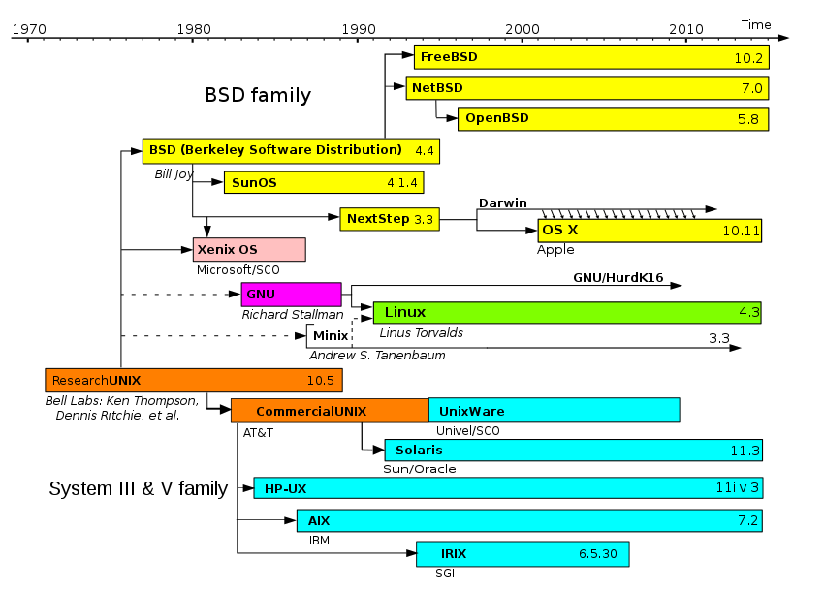
Unix-Like System Family Timeline

Slide 6
Linux
Unix Like
Assembled under the model of free and open-source software development and distribution
Linux kernel
The largest installed base of all general-purpose operating systems
Linux is also the leading operating system on servers
Runs on embedded systems
Linux is packaged in a form known as a Linux distribution

Slide 7
Ubuntu & Red Hat
Ubuntu
Debain based,
Mostly for personal computers, smartphone platforms, and some servers
Mostly non-commercial purposes
Most popular operating systems running in hosted environments, so–called "clouds", as it is the most popular server Linux distribution.
People are encouraged to use free software, study how it works, improve upon it, and distribute it
16.04 released 21 April 2016

Slide 8
Ubuntu & Red Hat
Red Hat
Red Hat Enterprise Linux
Targeted towards the commercial market
Third-party derivatives can be built and redistributed by stripping away non-free components of the distribution.

Slide 9
GUI vs CLI
GUI: Grahpic User Interface
Introduced in reaction to the perceived steep learning curve of command-line interfaces (CLI)
Examples of GUI of Linux:
X a windowing system for bitmap (a mapping from some domain to bits) displays
Version 11 (hence "X11") since September 1987
Does not mandate user interface, so a great verity

Slide 10
Wayland
A simpler replacement for X, easier to develop and maintain. GNOME and KDE are expected to be ported to it
A computer protocol that specifies the communication between a display server (called Wayland compositor) and its clients
Unifies the user interfaces
Current stable version: 1.12 released 9-21 2016

Slide 11
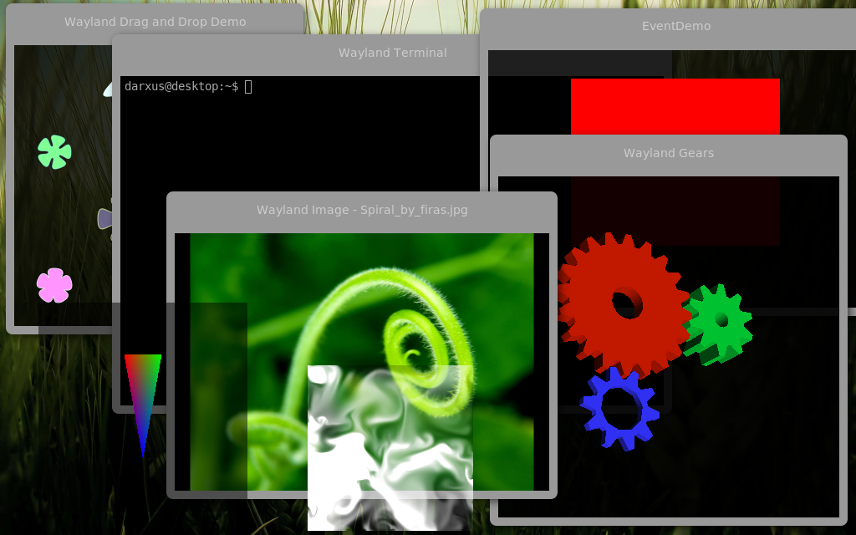
Wayland

Slide 12
GUI vs CLI
CLI: command-line interfaces
Shell is a user interface for access to an operating system's services
Usually a command-line interpreter or shell that provides a traditional Unix-like command line user interface
First released in 1989

Slide 13
Examples of CLI
Bash
A command processor that typically runs in a text window, where the user types commands that cause actions.
Bash can also read commands from a file, called a script.
Xterm
A standard terminal emulator for the X Window System
Can be within a graphical interface

Slide 14
Unix file system layout
The file system is considered a central component of the operating system
Provides information storage and retrieval, and one of several forms of interprocess communication.

Slide 15
Everything is a file — Device Files
Entry points to terminals, printers, and mice
An interface for a device driver that appears in a file system as if it were an ordinary file
They allow software to interact with a device driver using standard input/output system calls, which simplifies many tasks and unifies user-space I/O mechanisms.

Slide 16
Important Directories
/ The slash / character alone denotes the root of the file system tree.
/bin Stands for binaries and contains certain fundamental utilities
/boot Contains all the files needed for successful booting process
/dev Stands for devices.
/ etc Contains system-wide configuration files and system databases
/home Contains user home directories on Linux and some other systems
/lib Originally essential libraries
/opt Contains locally installed software
/usr The user file system
/var Stands for variable
/log Contains system log files.

Slide 17
Unix permissions
Owner permissions − The owner's permissions determine what actions the owner of the file can perform on the file.
Group permissions − The group's permissions determine what actions a user, who is a member of the group that a file belongs to, can perform on the file.
Others permissions − The permissions for others indicate what action all other users can perform on the file

Slide 18
Unix permissions
ls -l command displays various information related to file permission
10 digits
Read (R) write (W) execute (X)
Chmod = / - / +
Chown [user] file

Slide 19
Unix permissions
The SUID and SGID bits will appear as the letter "s"
Located in the permission bits where the owners execute permission would normally reside.
A capital letter S in the execute position instead of a lowercase s indicates that the execute bit is not set.
Execute as the owner/group permissions not the user
$ ls -l /usr/bin/passwd
-r-sr-xr-x 1 root bin 19031 Feb 7 13:47 /usr/bin/passwd*

Slide 20
The Basics: Moving Around
pwd: print working directory
cd: change working directory
~: home directory
.: current directory
/: root directory, or directory separator
..: parent directory

Slide 21
The Basics: Dealing with Files
The basics continued…
mv: move a file (no undos!)
cp: copy a file
rm: remove a file
mkdir: make a directory
rmdir: remove a directory
ls: list contents of a directory
-d: list only directories
-a: list all files including hidden ones
-l: show long listing including permission info
-s: show size of each file, in blocks

Slide 22
The Basics: File Name Matching
?: matches any single character in a filename
*: matches one or more characters in a filename
[]: matches any one of the characters between the brackets. Use ‘-’ to separate a range of consecutive characters.

Slide 23
The Basics: Look These Up
cat
head
tail
du
ps
kill
diff
cmp
wc
sort

Slide 24
The Basics: Redirection
> file: write stdout to a file
>> file: append stdout to a file
< file: use contents of a file as stdin

Slide 25
The Basics: find
-type: type of a file (e.g,, directory, symbolic link)
-perm: permission of a file
-name: name of a file
-prune: don’t descend into a directory
-o: or
-ls: list current file

Slide 26
Vi Editor
VIM
- Normal: Enter commands
Insert: Insert text
ESC
:qw
!
Highlight, record, insert, replace

Slide 27
Emacs
Much more powerful compares to VIM
Anything without using mice
show multiple files at once
A little bit hard to start
Avalible to almost all systems including embedd systems just like vim

Slide 28
Intro to Emacs
Three keys : C & Alt (M) ESC some times type words
Sequential commands
emacs filename
CTRL-x CTRL-c exit
CTRL-x CTRL-s save
CTRL-a go to beginning of the line
CTRL-e go to end of the line
ESC < go to the beginning of the file
ESC > go to the end of the file
CTRL-y re-insert ('yank') the last text that was killed
ESC w copy the marked region

Slide 29
Intro to Emacs
CTRL-h a FUNCTION lists commands related to FUNCTION
CTRL-h F FUNCTION get help about the specified function
CTRL-x 1 get rid of Help window
ESC CTRL-v scroll Help window forward
CTRL-g cancel partially typed or accidental command
CTRL-x u undo the last change
ESC-x list-matching-lines lists all the lines matching your pattern in a separate buffer, along with their numbers.
Use ESC-x goto-line to go to the occurrence you're interested in.
ESC v scroll to previous screen

Slide 30
Helpful Emacs Resources
Emacs Basics
http://mally.stanford.edu/~sr/computing/emacs.html
Colorado State University CS Department
https://www.cs.colostate.edu/helpdocs/emacs.html

